Slide 1


Interactive Wave Physics Simulator

Slide 2
Project Overview
Purpose
Provide an educational tool to understand better the concept of waves
Functionality
- Simulate and display different types of waves
Theme
Waves and Modern Physics (203-SN3-RE)
- Allow users to adjust wave parameters and instantly observe effects
- Display equation and graphs relating to the simulation
- Export visuals for reports or presentations

Slide 3
Interface Visuals
Top: Menu bar (File, Export, Help)
Left Panel: Controls for wave parameters (frequency / amplitude / speed / wavelength / etc.) and wave type.
Center: Animated wave visualization (2D graph for displacement to position or time).
Right Panel: Additional controls (second wave / damping / clear / etc.)
Bottom: Real-time equation display.

Slide 4
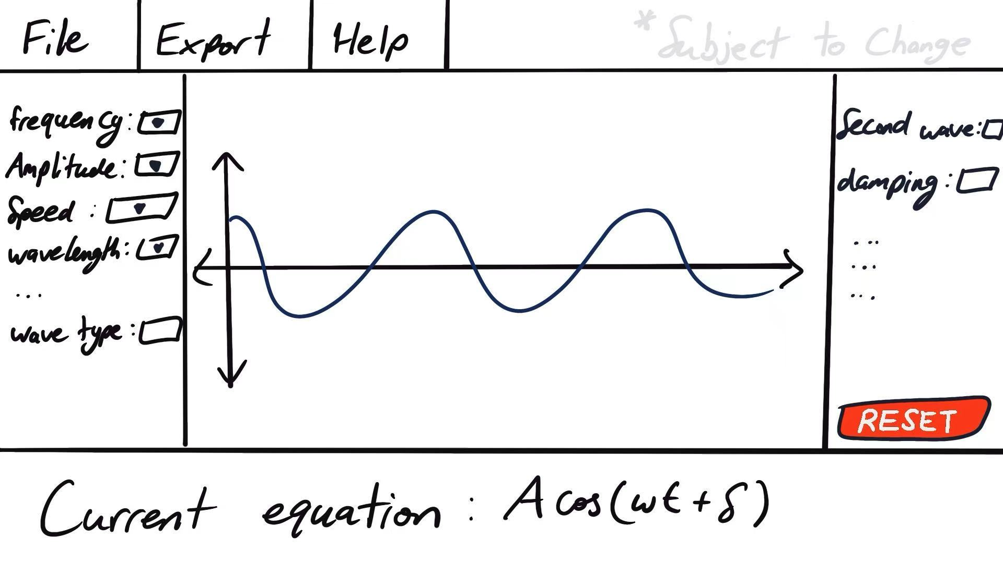
Interface Visuals

Slide 5
Implementation Summary
Technical overview:
Libraries and Tools:
Project Structure:
Programming Language: Java 22
Framework: JavaFX 22 (for GUI / Visualization)
JavaFX22 - GUI and visualization
ChartFX - Chart Animation Library
*Note that this is subject to change as we progress.*
- Main.java: Main program to run / Application entry point.
- WaveSimulator.java: Core logic for wave calculations.
- WaveDisplay.java: JavaFX scene for drawing waves animation and parameter controls.
- ExportManager.java: Handles exporting current visualizations as image files.
- Utils.java: Utility functions / tools for calculations.
*Note that this is subject to change as we progress.*

Slide 6
Project Planning
Trello：
We will be using Trello to plan and track our tasks during the development process.
Team members will be assigned to specific tasks and will update the status on Trello as members progress.
GitHub:
We will be using GitHub for version control, and each team member will review the work before merging.
The repository owner does not mean to be the one who does the most work.

Slide 7
Q&A / Conclusion
Reference:
OpenStax, University Physics Volume 1
Macmillan Learning, Physics for Scientists and Engineers 6e

